Slide 1




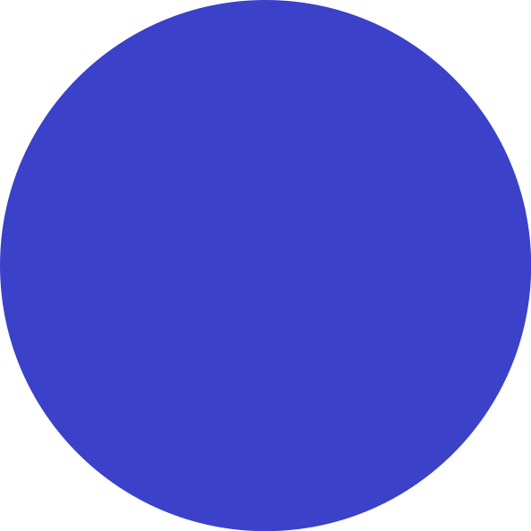
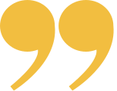


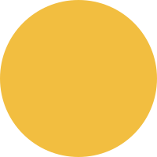



Official (Closed) - Non Sensitive
PROGRAMMING
FUNDAMENTALS
JS Fundamentals 1
DIPLOMA IN FULL-STACK DEVELOPMENT
Certificate in Computing Fundamentals
Continuing Education & Training (CET)

Slide 2
Loops

Slide 3
DEFINITION
Repetition aka. Loop control structure.
Loops check a condition. If it returns true, a code block will run. Then the condition will be checked again and if it still remains true, the code block will run again. It repeats until the condition returns false
Loops Repeats tasks while condition(s) is/are met

Slide 4
DEFINITION
Each time we perform a loop action,
it is known as an iteration.
Loops Repeats tasks while condition(s) is/are met

Slide 5
REMEMBER
Loop, provide a way to repeat the same set of actions over and over again.
#Simplify #RepetitiveTasks

Slide 6
For Loops

Slide 7
for (let i = 0; i < 10; i++){ console.log("Practice:" + i); }
Official (Closed) - Non Sensitive
Example: Display the word "Practice: x" using for loop
OPENING
CURLY BRACE
(START OF LOOP)
INCREMENT/UPDATE
KEYWORD
INITIALIZATION
CONDITION
Output
Practice: 0
Practice: 1
Practice: 2
Practice: 3
Practice: 4
Practice: 5
Practice: 6
Practice: 7
Practice: 8
Practice: 9
Loop stops because
i < 10
Q. How do we loop 10 times and get number 10?
CODE TO EXECUTE DURING LOOP (INSIDE THE LOOP)
CLOSING
CURLY BRACE
(END OF LOOP)

Slide 8
for (let i = 0; i < 10; i++){ console.log("Practice:" + i); }
INITIALISATION (Begin)
CONDITION
INCREMENT / UPDATE (Step)
Create a variable and set it to 0
Acts as a counter
Loop continues to run until the counter reaches a specific number
Every time the loop has run the statements in the curly braces, it adds one to the counter
let i = 0;
i < 10;
i++
Variable is only created the first time the loop is run.
The value of i was initially set to 0, so in this case the loop will run 10 times before stopping.
One is added to the counter using the increment (++) operator.
It is also possible for loops to count downwards using the decrement operator (--)
Runs AFTER the block of code is executed
CODE SAMPLE

Slide 9
for (let i = 1; i < 5; i++){ console.log("Thanks!:" + i); }
Example: Suppose we want to print a statement 5 times
Inline variable declaration. Variable i is only visible within the loop
Explanation
Step 1: a variable is initialized with value = 1. This is done once.
Step 2: Condition is checked, if it is true, statement will be displayed
Step 3: i = variable is incremented to display it again
Step 4: Again condition will be checked and step2 and step3 would be followed until the condition returns false

Slide 10
While Loops

Slide 11
While Loops

Slide 12
While Loop
While loop runs a block of code as long as any specific condition is true
Start
Condition
false
true
Code
End

Slide 13
while (i < 10){ console.log("Practice:" + i); i++; }
Example: Display the word "Practice: x" using while loop
INITIALIZATION
let i = 0;
OPENING
CURLY BRACE
(START OF LOOP)
KEYWORD
CONDITION
Output
Practice: 0
Practice: 1
Practice: 2
Practice: 3
Practice: 4
Practice: 5
Practice: 6
Practice: 7
Practice: 8
Practice: 9
Loop stops because
i < 10
Q. What if we take out the increment?
OR i = 10
CODE TO EXECUTE DURING LOOP (INSIDE THE LOOP)
INCREMENT
https://repl.it/@malcolmyam/wk06-basic-js
CLOSING
CURLY BRACE
(END OF LOOP)

Slide 14
WHILE LOOPS
Basically a while loop is the same as a for loop; however, sometimes, you may not know how many times it will iterate (repeat).
The while loop repeats as long as the condition is true.
One disadvantage of using while loop is that it’s easier to end up with an infinite loop, which may cause your computer to hang because the loop will run forever until the browser is out of memory. #dontbelievetryit

Slide 15
VS
FOR LOOP
WHILE LOOP
for (let i = 0; i < 10; i++){ console.log("Practice:" + i); }
let i = 0;
while (i < 10){ console.log("Practice:" + i); i++; }
Both are equivalent and produce the same results

Slide 16
do{ console.log("Practice:" + i); i++; }while (i < 10)
Example: Display the word "Practice: x" using do.. while loop
INITIALIZATION
let i = 0;
OPENING
CURLY BRACE
(START OF LOOP)
KEYWORD
CONDITION
Output
Practice: 0
Practice: 1
Practice: 2
Practice: 3
Practice: 4
Practice: 5
Practice: 6
Practice: 7
Practice: 8
Practice: 9
Loop stops because
i < 10
Q. What if we take out the increment?
OR i = 10
CODE TO EXECUTE DURING LOOP (INSIDE THE LOOP aka loop body)
INCREMENT
This form of syntax should only be used when you want the body of the loop to execute at least once regardless of the condition being truthy.
Usually, the other form is preferred: while(…) {…}.
CLOSING
CURLY BRACE
(END OF LOOP)
https://replit.com/@immalcolm/do-while

Slide 17
Loop Control
break

Slide 18
Loop Control
Those loop control statements can be used in both WHILE and FOR loops:
break - exit out of the loop completely
continue - skip the rest of the loop, and start a new iteration
Those are usually use together with a IF statement.

Slide 19
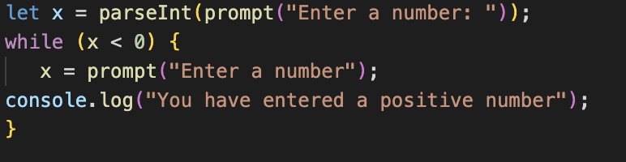
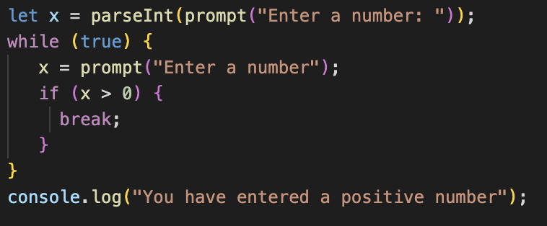
Break
This will just break out of the loop. We can rewrite the while loop that keep asking the user to key in a positive number till they enter one like this:
V1: Non breaking
Using Break
The break directive is activated if the x > 0. It stops the loop immediately, passing control to the first line after the loop. Namely, alert.

Slide 20
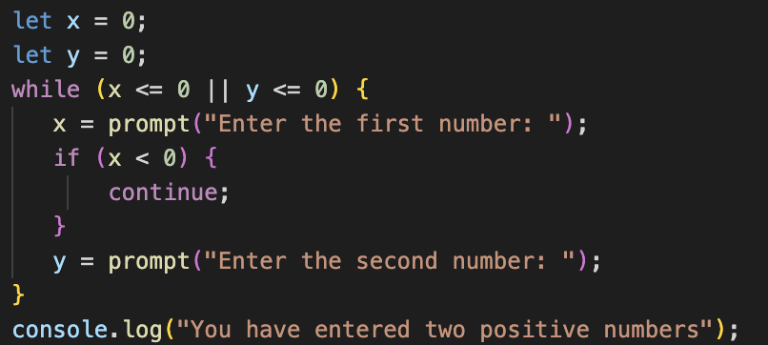
Continue
The continue statement will skip the rest of the loop and start a new iteration. (For a WHILE loop, the sentinel condition will be checked again).
The following code asks the user to key in two positive numbers:
The loop repeats if the first number is not positive

Slide 21
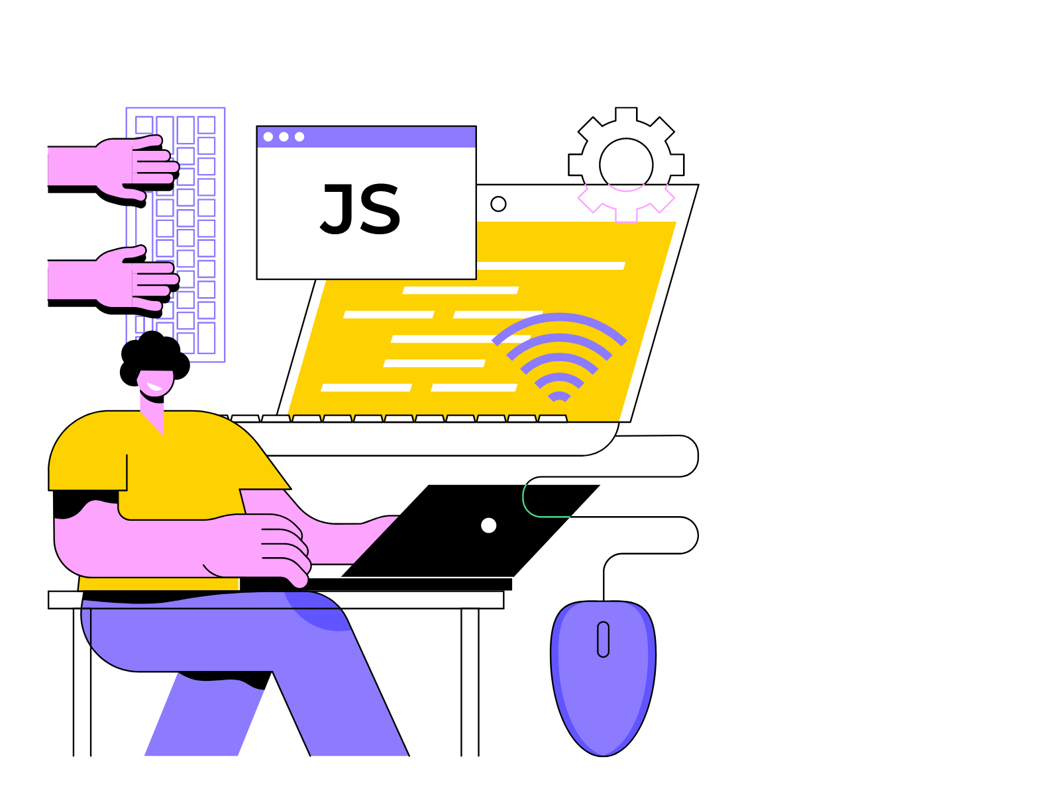
What we covered
3 Types of Loops
while – The condition is checked before each iteration.
do..while – The condition is checked after each iteration.
for (;;) – The condition is checked before each iteration, additional settings available.
To create a loop that runs indefinitely, the while(true) construct is commonly employed. This type of loop, like any other, can be terminated using the break directive.
When there's nothing to execute in the current iteration and the intention is to move directly to the next one, the continue directive can be used.

Slide 22
Arrays
Simple ones..

Slide 23
Arrays Importance
Arrays help us to avoid having many variables of different names
Instead of variables "name1", "name2", "name3",
just use an array called names[].

Slide 24
Arrays helps us to….
Organise many variables into a container
Make lists/groups/collections (Names, Numbers, etc)

Slide 25
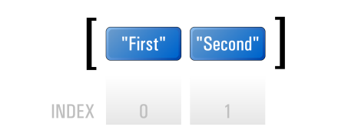
Array Terminology
element
index or subscript or key
console.log(list[0])
accessor

Slide 26
colors= [’pink’,’yellow’,‘green’];
ARRAY INDEXING
0
1
2
Elements
Think of the index as an address of this particular element in the memory.
‘Yellow’ is store at colors[1] that means on the second location in the array

Slide 27
Defining Arrays
Declare an array called list
let list=[];
list[0] = "First";
list[1] = "Second";
We can insert a variable into an array by specifying which index it goes into

Slide 28
Defining Arrays (Shortcut)
let list = ["First", "Second", "Third", "Fourth"];
0
1
2
3
console.log(list[0]);//"First"

Slide 29
Javascript Arrays are Special.
#ARRAYS #WK1
Unlike other languages, arrays in JavaScript can store values of different data types
let rojak = [1, 3.14, true, "Hello World!", function() { console.log("foobar!"); }];
Rojak is an array that stores an integer, a float, a string and a closure.
You can store number value, character values, etc all in one variable. What matters is the order of them.

Slide 30
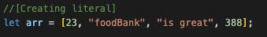
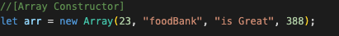
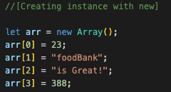
Creating Arrays
Array literal
Array Constructor
Creating instance with “new”

Slide 31
COMMON METHODS & PROPERTIES
METHOD
DESCRIPTION
pop()
Removes the last element in an array
push()
Adds a new element to array
Removes the first element in array
shift()
unshift()
Adds a new element to array
splice(a,b,<elements>)
a defines position where new elements are added
b defines how many elements to be removed
<elements> define new elements to be added
sort()
Sorts array alphabetically
indexOf()
Search the array for an element and returns its position
PROPERTY
DESCRIPTION
length
Number of keys
http://www.w3schools.com/jsref/jsref_obj_array.asp
Notes:
https://www.w3schools.com/jsref/jsref_obj_array.asp

Slide 32
Working with Arrays
Maximum length of an array
Use length to determine how many elements there are in an array
let list = [3, 10, 11]; console.log(list.length);
http://www.w3schools.com/jsref/jsref_obj_array.asp

Slide 33
Working with Arrays
Add to the end of an array
list.push(3);
http://www.w3schools.com/jsref/jsref_obj_array.asp

Slide 34
Working with Arrays
Remove and get the last element in array
list.pop();
http://www.w3schools.com/jsref/jsref_obj_array.asp

Slide 35
Working with Arrays
Return a selected portion of an array
let smaller_list = list.slice(2,5);
http://www.w3schools.com/jsref/jsref_obj_array.asp
Notes:
https://www.w3schools.com/jsref/tryit.asp?filename=tryjsref_slice

Slide 36
Working with Arrays
You can skip indexes in an array
let list = []; list[0] = "a"; list[26] = "z";
All the values you skip are filled with undefined

Slide 37
2D Arrays

Slide 38
Array in Array
let grid = [
["a", "b", "c"],
["d", "e", "f"],
]
// hint: start from 0!
grid[0][0] -- "a"
grid[1][2] -- "f"
// set index 0 of the array in index 1
// of grid value to g
grid[1][0] = "g";
grid
0
1
2
0
a | b | c
1
d | e | f

Slide 39
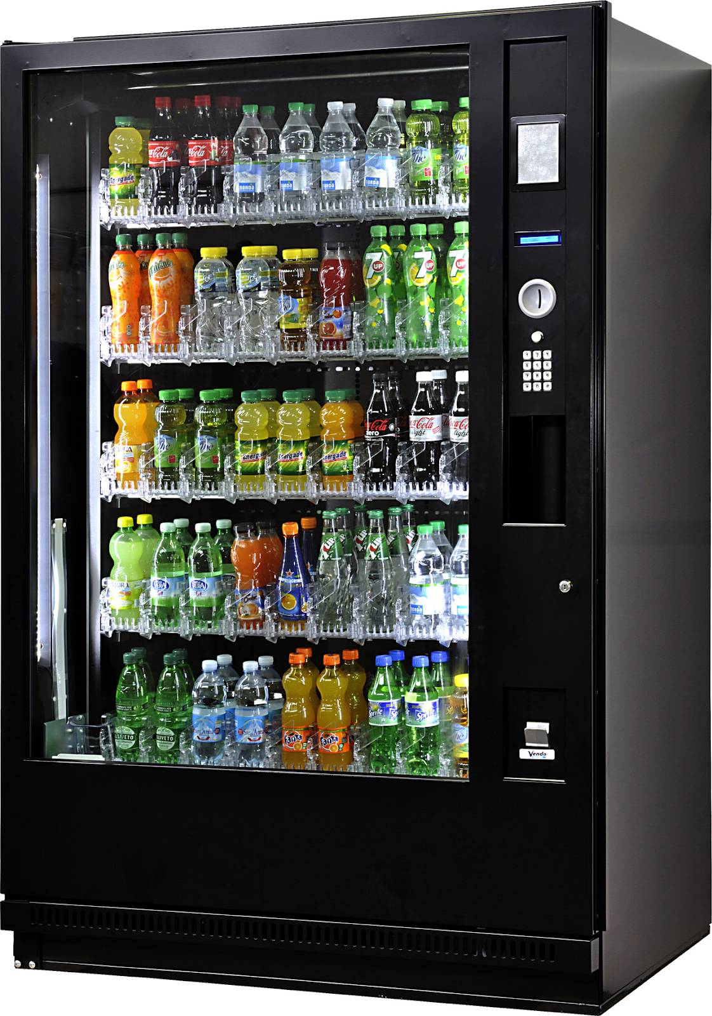
Example - Vending Machine
 | 0 | 1 | 2
0 | Oreo | Potato Chips | Twisties
1 | Kit Kat | Hello Panda (Chocolate) | Hello Panda (Strawberry)
2 | OK Pocky | Snickers | Cup Noodle

Slide 40
Associative Arrays

Slide 41
Associative Arrays
Normal arrays use integers as the index or subscript.
Associative arrays use strings as the index
In an associative array, the index or subscript is often known as the key.
Further Reading: Simply JavaScript, Page 34 - 35

Slide 42
How to use Associative Array
Simply use a string as the index instead of a number:
let country_codes = [];
country_codes["sg"] = "Singapore";
country_codes["uk"] = "United Kingdoms";

Slide 43
Functions

Slide 44
Functions
👩🏻‍💻
If I ask you to build a system that does the entry each time a student logs in, would it be helpful writing a code for adding this entry for each student individually and also everytime he/she logins in?

Slide 45
Functions
👩🏻‍💻
Writing code for the same task again and again can cause readability issue, prone to error, hard to maintain and debug.
We got functions as our savior 🥰

Slide 46
KEYWORD to depict function
FUNCTION name
Functions are a block of code to perform a specific task.
So now you don’t have to write the code for the same task over and over again but create a function and call it wherever the task is needed to be performed.
function sayHello() { console.log('Hello'); }
CODE BLOCK (IN CURLY BRACES)
sayHello();
To use the function we declared, we need to call it at the place it is needed to run.
FUNCTION NAME

Slide 47
function getArea(width, height) { return width * height; }
getArea(3, 5);
CALLING A FUNCTION THAT NEEDS INFORMATION
PARAMETER
PARAMETER
Having a return statement is optional however it’s a necessary good. It depends on your code utility.
THE PARAMETERS ARE USED LIKE VARIABLES WITHIN THE FUNCTION
ARGUMENTS
The () Operator invokes the function. Accessing a function without () will return the function object instead of the function result

Slide 48
function getArea(width, height, modifier = 10) { return width * height * modifier; }
getArea(3, 5, 100);
getArea(3, 5);
OPTIONAL DEFAULTS
You can mix normal arguments (aka. Positional arguments) with optional arguments when you call the function, but the former must come first.
PARAMETER
PARAMETER
OPTIONAL PARAMETER
The () Operator invokes the function. Accessing a function without () will return the function object instead of the function result

Slide 49
Immediately Invoked Function Expression IIFE
Pronounced as ‘iffy’

Slide 50
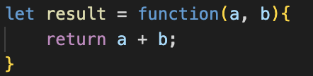
IIFE
👩🏻‍💻
Before diving into IIFE, let us understand what function expression is.
Function expression is a function defined as an expression.
What does that mean?
https://developer.mozilla.org/en-US/docs/Glossary/IIFE

Slide 51
IIFE
👩🏻‍💻
This is same as a function declaration but the difference lies in the fact that function expression are declared with the name of function and they won’t throw an error.
It is allowed using a function with no name(anonymous function) in function expression

Slide 52
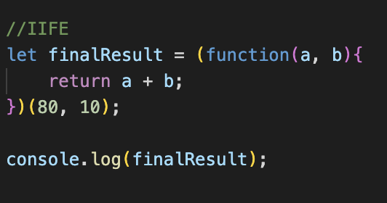
IIFE
👩🏻‍💻
Immediately invoked function(IIFE) is a design pattern that allows a function to be declared as an expression and executed immediately after creation.

Slide 53
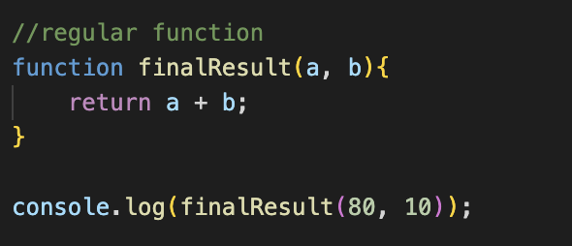
Regular Function vs IIFE
Whenever a regular function or variable is declared, JS engine adds it to the global object that results in their access before they are defined or in simpler words, regular function and variables are hoisted.
This results in the inefficient use of memory because memory won’t be relocated until the global object releases it.
To solve this issue we have IIFE, that are called immediately after creation. They are not hoisted.
Variable on which we assign this function will not be invoked afterwards

Slide 54
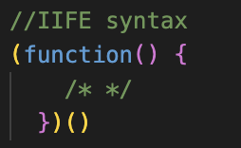
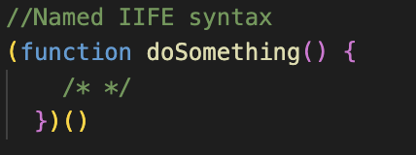
When to use IIFE?
A real world application of IIFE is when you want list of functions to run as soon as the page loads, using them would be clearer way of writing them. Something to use once, but won’t use again.
You would want to avoid name collisions by using IIFE
Notes:
https://medium.com/0xcode/iife-immediately-invoked-function-expressions-in-javascript-5178f5575e64

Slide 55
Arrow Function
Notes:
https://www.instagram.com/p/CfwHBfbjDU4/

Slide 56
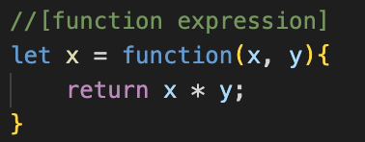
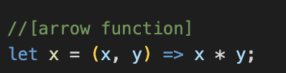
Arrow functions
Arrow functions allow us to write shorter and cleaner syntax as compared to regular functions.
They are more likely to be used when you want to create an anonymous function.
https://developer.mozilla.org/en-US/docs/Web/JavaScript/Reference/Functions/Arrow_functions

Slide 57
Function Expression vs Arrow Function
Noticed? Our variable remains the same
The `function` keyword is omitted with function symbol and the code remains the same for whatever task you are creating it for.
The arrow function is clearer and shorter
To call the arrow function, use x();

Slide 58
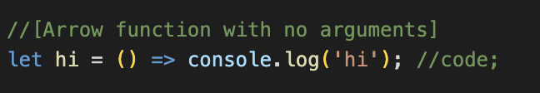
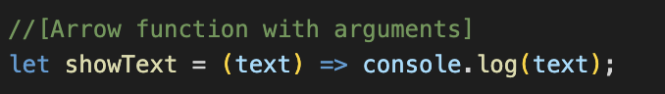
Ways to declare Arrow Function
Function with no arguments
When function doesn’t accept arguments, then you can use empty parentheses.
Function with arguments
Here you can use arguments inside parentheses. Works same as regular function but in shorter way.

Slide 59
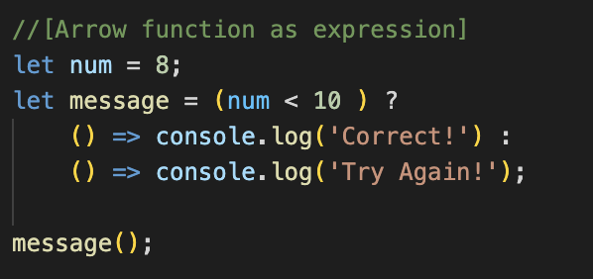
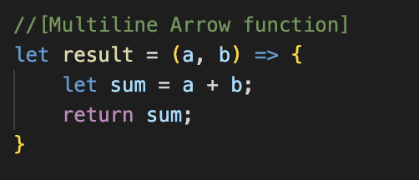
Ways to declare Arrow Function
Function as expression
You can easily use arrow function as expression. We are using with ternary operators.
Multiline function
We simply use curly braces to wrap the statements of a function

Slide 60
Drawbacks of arrow functions
When you want to refer to the function at some point in the code (maybe in the form of recursion or event handler that you want to use somewhere else as well.)
You won’t be able to easily debug the code because it has no name.
Notes:
https://medium.com/0xcode/iife-immediately-invoked-function-expressions-in-javascript-5178f5575e64

Slide 61
Variable Scope

Slide 62
Think of Scope as a "Context" for Variables
We need "scope" or else we'll run out of variable names
We may also accidentally reassign to important variables

Slide 63
What is a scope?
A set of curly braces form a scope:
let x = parseInt(prompt("Enter a number: ")); if (x > 0) { let y = parseInt(prompt("Enter a second number: ")); }
This is a scope

Slide 64
Variable in a Scope
A variable is only available in a scope that it is defined in.
If a variable is not inside a set of curly braces, then it is in the global scope.
Variable x is in the global scope
let x = parseInt(prompt("Enter a number: ")); if (x > 0) { let y = parseInt(prompt("Enter a second number: ")); }

Slide 65
Variable Access (part 1)
A line of code cannot access a variable not in its scope.
let x = parseInt(prompt("Enter a number: ")); if (x > 0) { let y = parseInt(prompt("Enter a second number: ")); } console.log(y);
Error! Out of scope!

Slide 66
Variable Access (part 2)
A line of code can access a variable that exist in the scope it is enclosed in
let x = parseInt(prompt("Enter a number: ")); if (x > 0) { let y = parseInt(prompt("Enter a second number: ")); console.log(x * y); }

Slide 67
Variable Access (part 3)
A line of code can access a variable that exist in the scope it is enclosed in
let x = parseInt(prompt("Enter a number: ")); if (x > 0) { let y = parseInt(prompt("Enter a second number: ")); if (y > 0) { let z = parseInt(prompt("Enter a third number: ")); console.log(x * y * z); } }
Define the y variable
The green scope is nested (or enclosed in) the yellow scope, so it can access variable y.

Slide 68
Variable Access (part 4)
A line of code can access a variable that exist in the scope it is enclosed in
let x = parseInt(prompt("Enter a number: ")); if (x > 0) { let y = parseInt(prompt("Enter a second number: ")); if (y > 0) { let z = parseInt(prompt("Enter a third number: ")); console.log(x * y * z); } }
The yellow scope enclosed in the global scope, so it can access the global variable x

Slide 69
Overwriting Variable Names
When a line of code looks for a variable, it will check its own scope, then the scope above it and so on.
let myNumber = 3; {
let myNumber = 4; console.log(myNumber);
}
Because there is a definition of myNumber in this scope, the console.log(myNumber) will use that local variable instead of the global one.

Slide 70
Important!
As a programmer, you must always know the purpose and origin of every variable you define in a program.

